Slide 1

PROJECT – 1
Stock Price Forecasting for ICICI Bank using Hybrid Approach
Submitted towards the partial fulfillment of the criteria for award of Post Graduate In Data Analytics by Imarticus
Submitted By: Naresh Ganapathi Member (Roll # IL034010)
Course and Batch: PGA WE03 2023

Slide 2
Scope & Objective
The objective of this project is to forecasting share price of “ICICI Bank” by using Time series models. It will provide useful information for the investors, banks and insurance companies to make decisions on investing their funds properly for better returns. For successful investment, many investors are interested to know about the future situation of the market. Effective prediction systems indirectly help traders by providing supportive information such as the future market direction
Business Problem Statement
Stock price prediction is a method to determine the value of a company, so one can buy or sell their stocks accordingly, to gain the significant profits out of it. The rate of investment and business opportunities in the Stock market can increase if an efficient model could be built to predict the short-term price of an individual stock. As Prediction of share prices being challenging task for many investors, this project aims at predicting stock price with the help of Time series models.

Slide 3
Data Sources
The required Dataset for predicting share price of ICICI Bank are imported from “nsepy” object library of
Python as it is extracting data from National Stock Exchange (NSE)’s website.
The Dataset contains the information related to the features of the daily share price observations of ICICI Bank from 1st June 2022 to 1th June 2023. The Dataset comprises 14 features and more than 3,000 data points.
The Dataset contains the following features:
[“Date”, “Series”, “PrevClose”, “Open”, “High”, “Low”, “ltp”, “close”, “VWAP”, “Volume”, “52WH”,
“52WL”, “value”, “ No of trades ” ]
Analytics Tools
Python is the language of choice and jupyter notebook is the plotform for this project and the below packages
of python are used predominantly in this project.
pandas
numpy
sklearn
scipy.stats
nsepy
matplotlib
seaborn

Slide 4
Limitation of the Share price forecasting :
Share prices are influenced by a wide range of factors, including market sentiment, geopolitical events, news, and more. Time series models may not fully capture the impact of sudden external events.
Time series models mainly rely on historical price data and excluding some other economic indicators.
The length of historical data available can impact the effectiveness of time series models.
It's important to note that even with advanced models, there's no guarantee of accurate predictions.

Slide 5
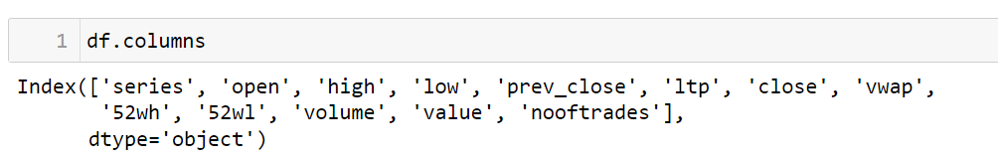
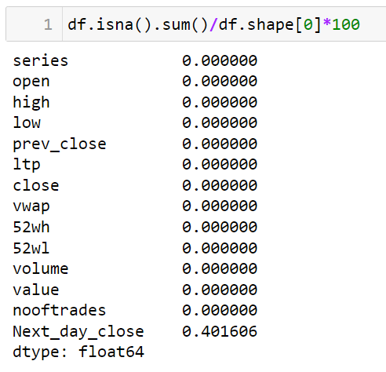
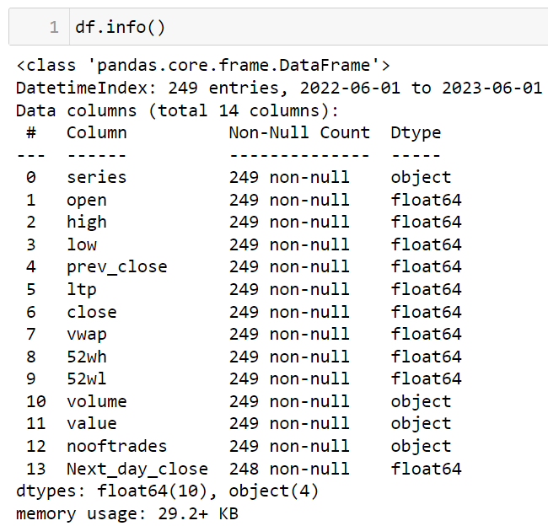
Approach used in this project:
The following approaches are implemented in this project.
Examined the dataset as a first step:

Slide 6
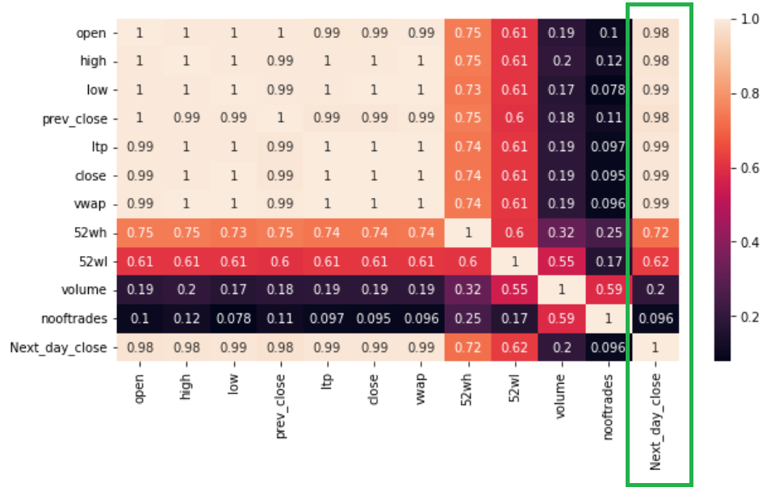
The necessary features are selected by using Pearson’s correlation method and visualized using
heatmap.

Slide 7
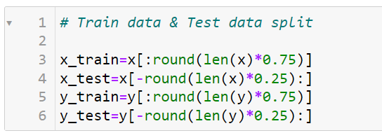
Split the Dataset into Train and Test in order to evaluate the performance of the model.
Train = 75% of the data
Test = 25% of the data

Slide 8
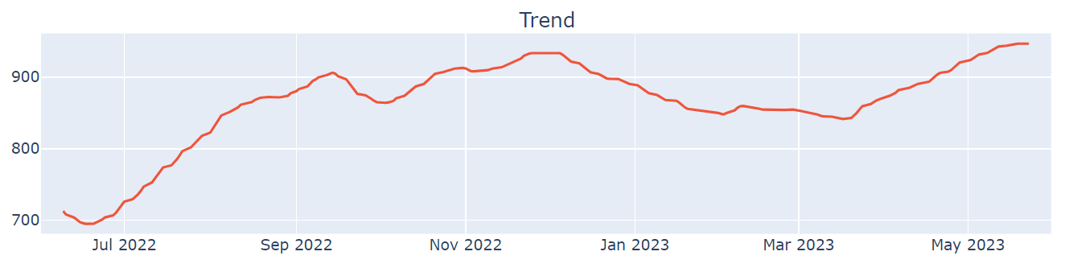
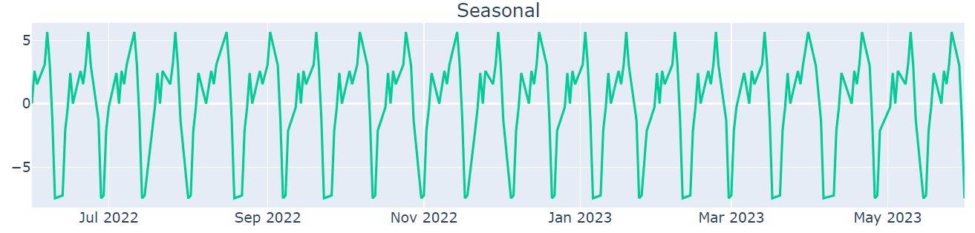
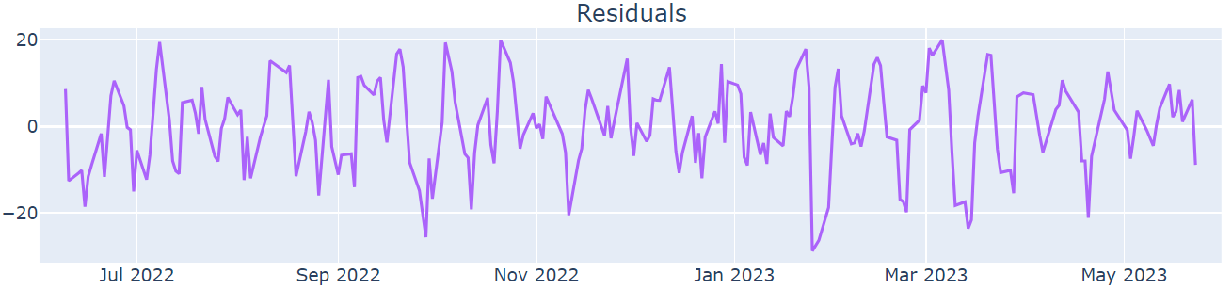
Seasonal decompose are performed and plotted.

Slide 9
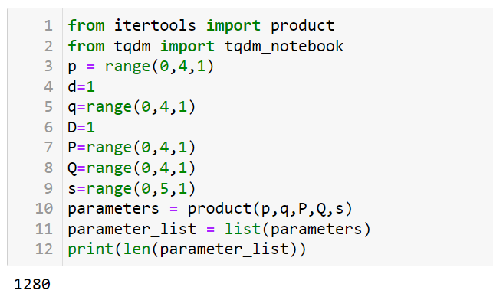

In order to select the best parameters for SARIMAX model used 1280 combinations of parameters
Selected the below parameter for the SARIMAX model based on least MAPE value

Slide 10
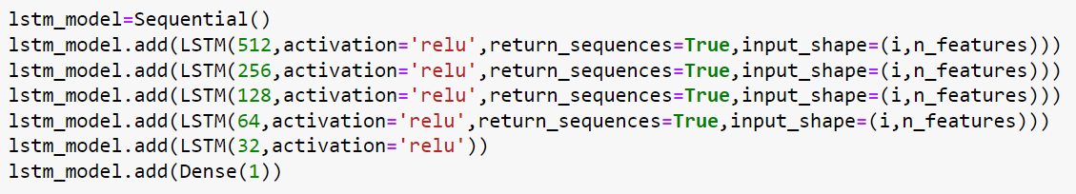
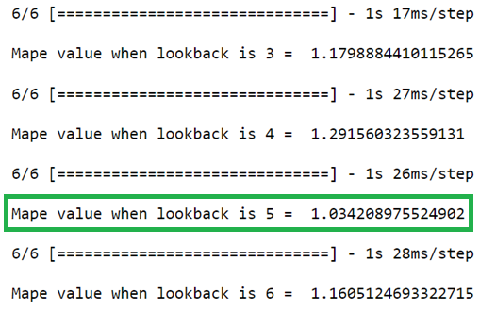
Using residual of SARIMAX model built LSTM model by evaluating the Mape for different
look backs and selected 5 as a look back for the model

Slide 11
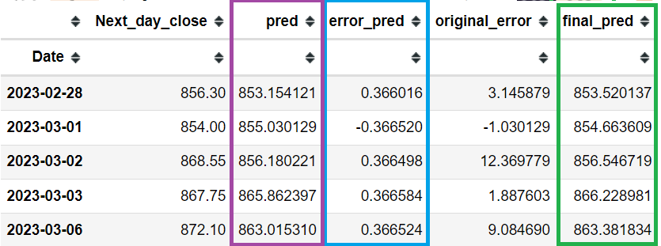
Added the prediction of LSTM with the output of SARIMAX for the Final prediction.

Slide 12
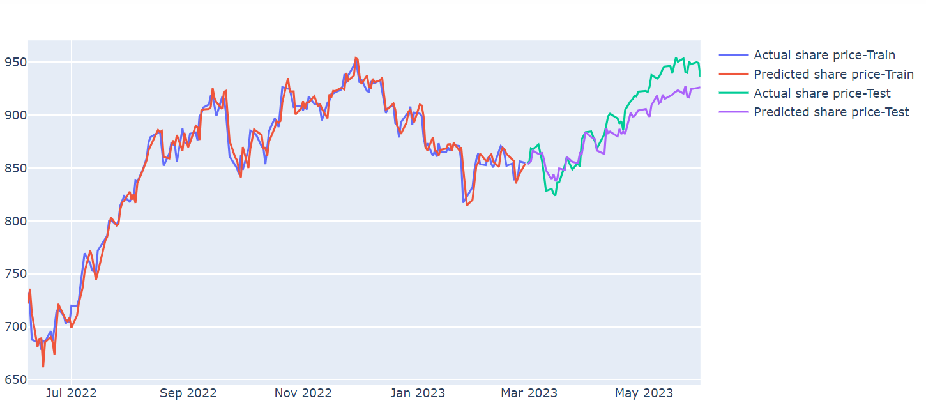
Over all performance of the model ( SARIMAX + LSTM)

Slide 13
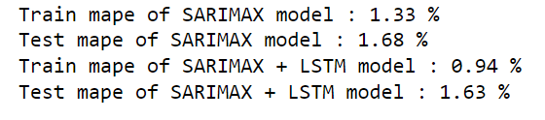
Mean absolute percentage error of SARIMAX and Hybrid Model ( SARIMAX + LSTM)

Slide 14
Conclusion :
The project focused on share price forecasting utilizing a combination of time series models, specifically SARIMAX and LSTM.
The utilization of SARIMAX allowed us to capture some level of seasonality and trend patterns present in the historical data.
LSTM, being a more advanced model, showcased its capability to capture non-linear patterns and dependencies within the residual.
The Hybrid model prepared to get more accurate forecasting of share price, But we must remember that the financial world is always changing, and unexpected events can shake things up, which even the best models might not foresee.
We believe this project will set the stage for more research and improvement in share price forecasting in the future

